Slide 1

HustlerCore: AI-Powered Income Protection for India's Delivery Partners
Data Decypher’s Welcomes You!

Slide 2
Data Decypher’s
Arjun Jha RA2411026010716
Avinash Santhosh Nair RA2411026010726
Ayushman Bahinipati RA2411026010729
Ramyapriya Sivasankar RA2411026010734
Prasanth Choudary RA2411026010743 SRM Institute of Science and Technology

Slide 3







Table of contents
01.
Problem Statement
04.
Flowcharts
02.
Idea
05.
Roadmaps
03.
03.
Features
06.
Conclusion

Slide 4
Introduction
01. Problem Statement
India’s platform-based delivery partners (Zomato, Swiggy, Zepto, Amazon, Dunzo etc.) are the backbone of our fast-paced digital economy. However, external disruptions such as extreme weather, pollution, and natural disasters can reduce their working hours and cause them to lose 20–30% of their monthly earnings. Currently, gig workers have no income protection against these uncontrollable events. When disruptions occur, they bear the full financial loss with no safety net.
02. Our idea
Our Idea involves developing a model-based product designed to solve the specified problem statement and elevate the user's working experience with a range of innovative features.
The project can be broken down into two parts.
03. Chosen Persona and Pricing Model
Food Delivery Partners - Zomato / Swiggy
Weekly tiers: ₹49 · ₹99 · ₹149, Dynamic, AI-adjusted each week

Slide 5
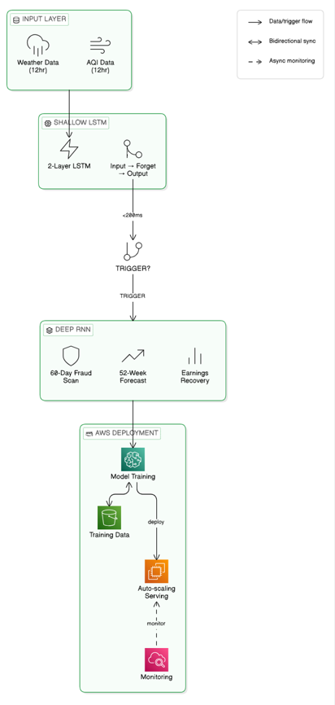
Part 1: Server Side AI engine
Shallow LSTM (2-Layer)
Always on trigger classifier. Processes 12hr weather & AQI time series through Input→Forget→Output gates. Binary output: TRIGGER / NO TRIGGER in <200ms.
Deep RNN (4-Layer)
Invoked on trigger only. Handles: (A) weekly premium forecasting via 52 week zone history, (B) fraud sequence detection on 60 day behavioral patterns, (C) earnings recovery projections.
AWS Deployment
ML training on AWS SageMaker → model served via EC2 with auto-scaling → training data stored in S3 → system health monitored via CloudWatch

Slide 6
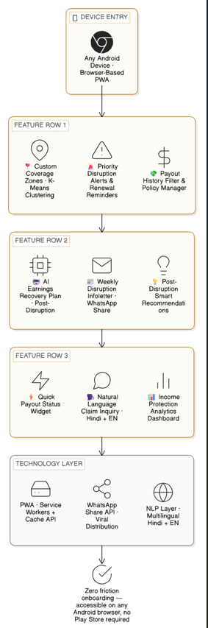
PART 2 — HustlerCore Worker App
Mobile First Progressive Web
App 9 AI powered features. Accessible on any Android device via browser no app download required. Shareable via WhatsApp URL.
Priority Disruption Alerts & Renewal Reminders
Custom Coverage Zones (K-Means clustering)
Payout History Filter & Policy Manager
AI Earnings Recovery Plan (post-disruption)
Weekly Disruption Infoletter (WhatsApp share)
Post-Disruption Smart Recommendations
Quick Payout Status Widget
Natural Language Claim Inquiry (Hindi + EN)
Income Protection Analytics Dashboard

Slide 7
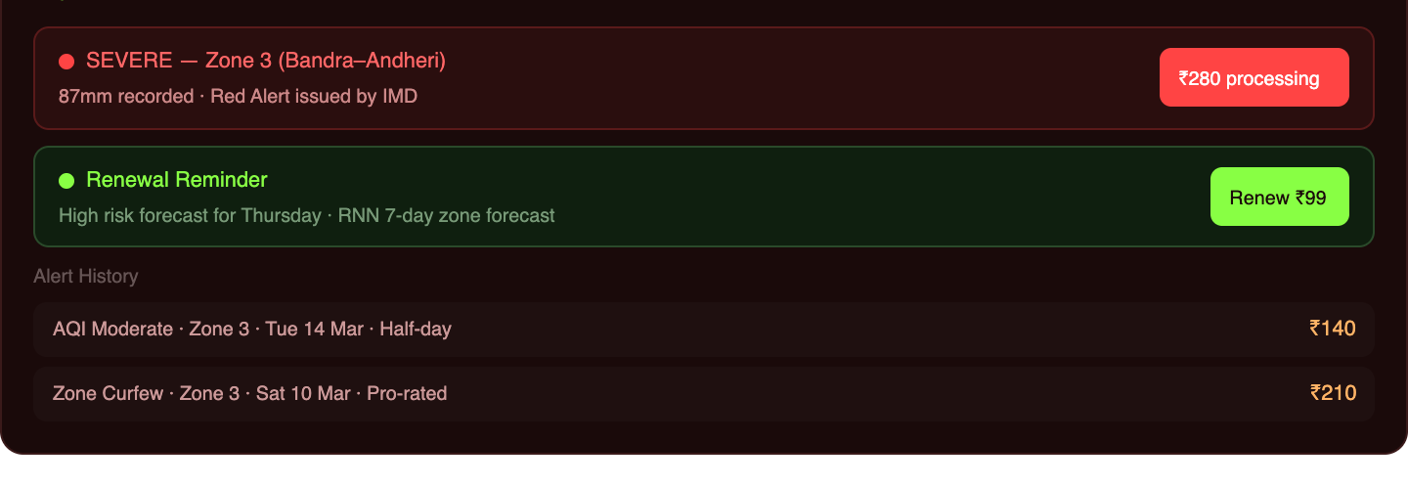
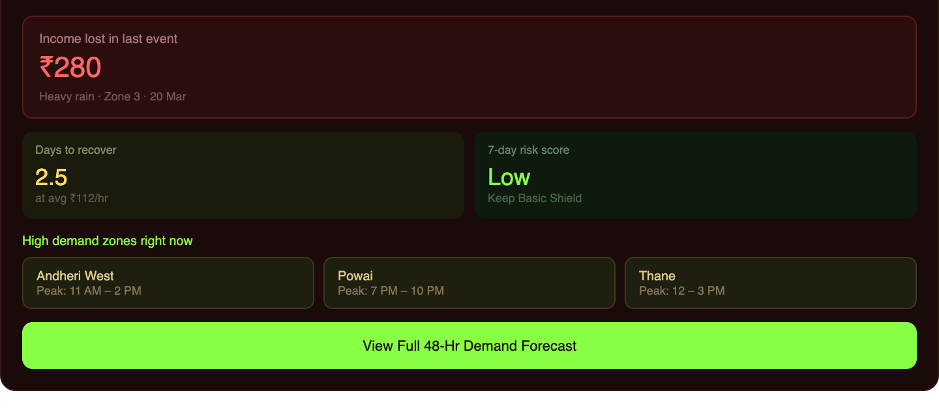
Feature 01 - Priority Disruption Alerts & Renewal Reminders
The Shallow LSTM continuously monitors weather, AQI and civic feeds. When a disruption threshold reaches 80%, it grades the event as Minor, Moderate or Severe and pushes an instant priority alert to the worker's phone.
Renewal reminders are timed 6 hours before a high-probability disruption event, sourced from the Deep RNN 7-day zone forecast.
Feature 02 - AI-Generated Earnings Recovery Plan
After every payout event, the Deep RNN generates a personalized recovery plan covering projected days to earn back lost income, peak demand zones still operating in the city, and optimal delivery hours for the next 48 hours.
A 7-day forward earnings protection score also advises whether upgrading the current plan is recommended, turning HusterCore into an active financial planning tool.

Slide 8
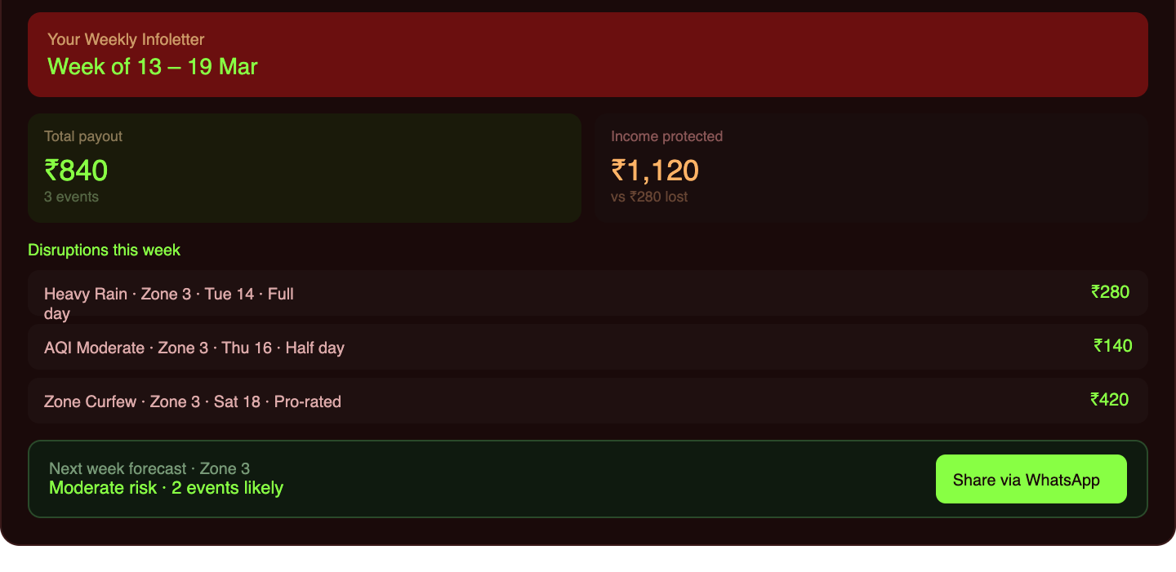
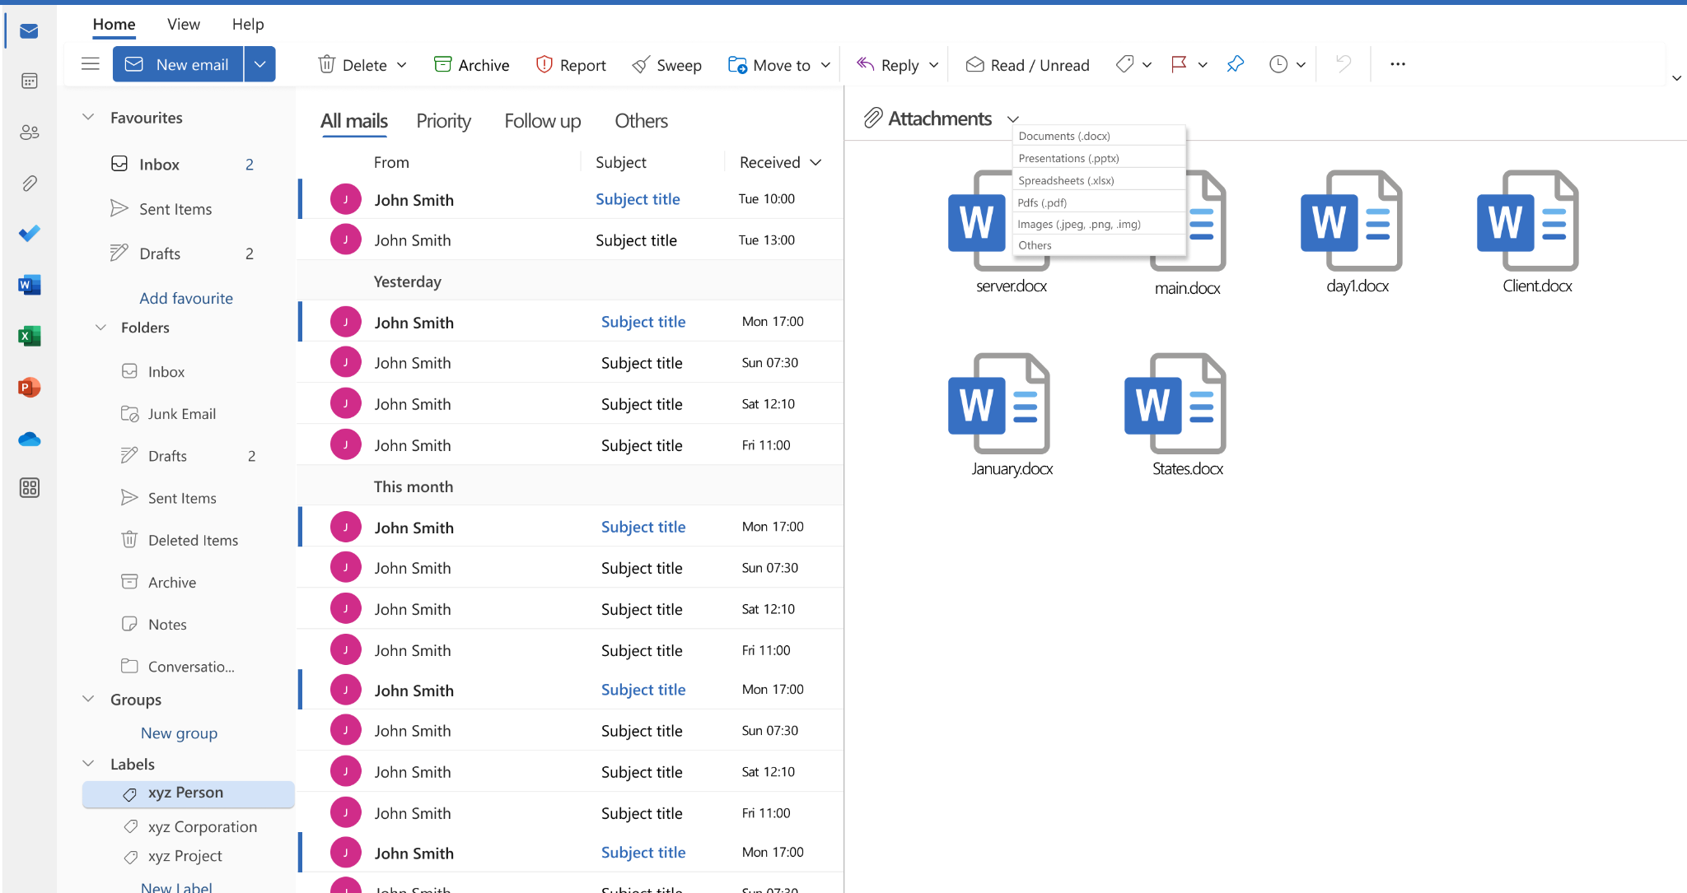
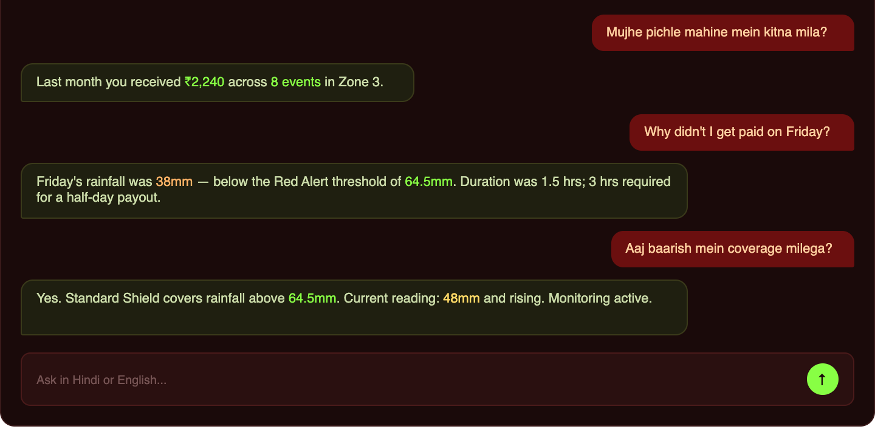
Feature 03 - Weekly Disruption Infoletter
Every Monday, HustlerCore auto-generates a personalized Infoletter for each worker covering disruption events in their zone, total payouts credited, income protected versus income lost, and a next-week forecast powered by the Deep RNN.
Workers can share their Infoletter via WhatsApp, making it a credible and zero-cost acquisition channel for HustlerCore.
Feature 04 - Natural Language Claim Inquiry
Workers can ask free-text questions about their payouts and policy in plain Hindi or English with no menus or forms required. Powered by a fine-tuned DistilBERT model, the engine clearly explains why a payout was or was not triggered, reducing worker confusion and building trust in the platform.

Slide 9
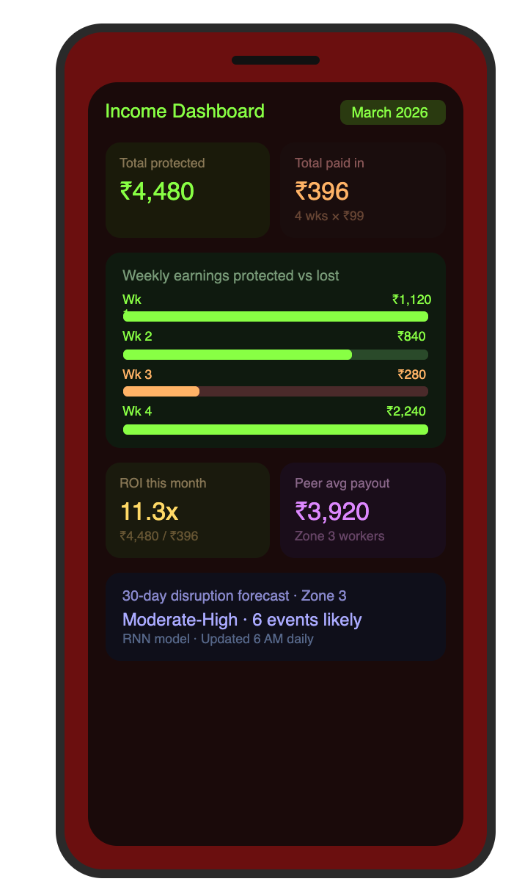
Feature 05 - Income Protection Analytics Dashboard
The system provides workers with a comprehensive dashboard that displays earnings protected versus baseline, along with a zone-specific disruption heatmap, enabling better understanding of coverage impact and environmental risks.
It offers a premium versus payout ROI tracker and a 30-day forecast powered by the Deep RNN, helping users make informed financial decisions and anticipate future outcomes. Additionally, an anonymized peer comparison feature benchmarks the value of staying covered, encouraging data-driven participation.
In admin mode, the platform delivers live trigger monitoring, fraud detection queues, and model performance metrics, enabling operations teams to efficiently manage system activity and ensure reliability.

Slide 10
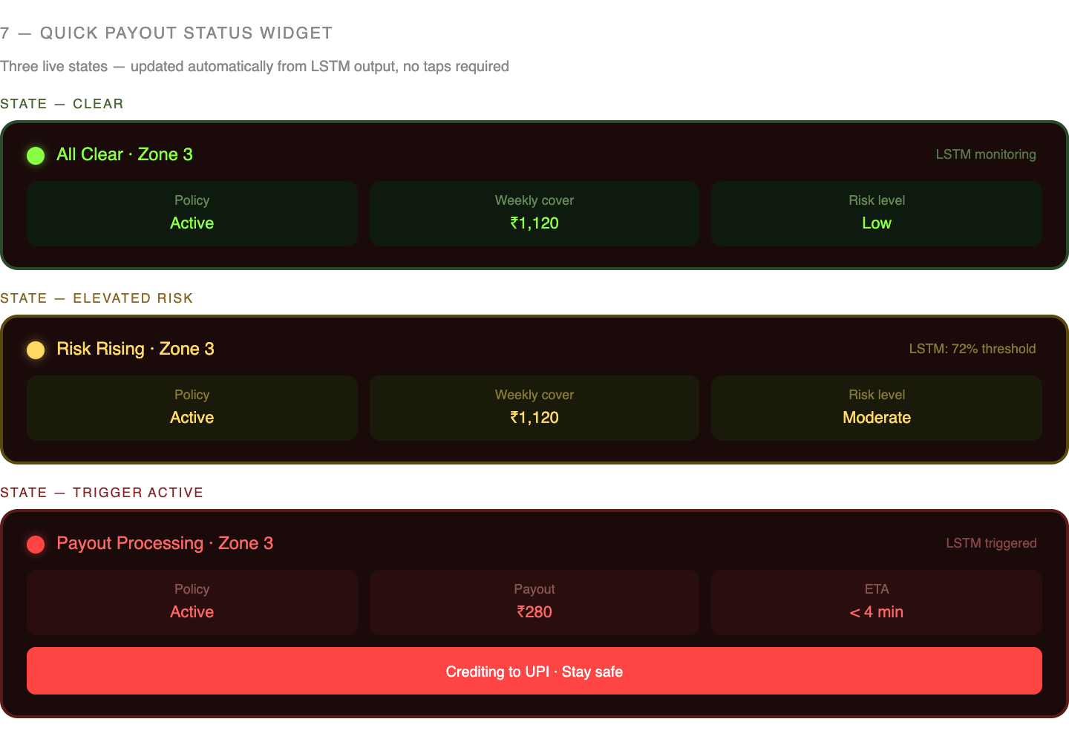
Feature 06 - Quick Payout Status Widget
An integrated home screen display which shows workers a live coverage read without accessing the app. It indicates active policy status, weekly cover and the disruption watch level of their zone color-coded directly out of the live output of the LSTM, with a green indicating clear, amber indicating high potential risk, and red indicating an active trigger with a payout processing.
No taps, no navigation it changes itself automatically in the background.

Slide 11
Adversarial Defense & Anti-Spoofing Strategy
Threat Context: A 500-worker Telegram syndicate used GPS-spoofing apps to drain a competitor's liquidity pool in a single red-alert event. Simple GPS verification is obsolete.
1. The Differentiation — 7-Signal Behavioral Fingerprint A spoofer can fake GPS. They cannot fake all 7 signals at once.
Cell tower triangulation — pings towers near home, not the disruption zone
Accelerometer / IMU — home stillness pattern vs. natural sheltering movement
WiFi SSID — connected to home network, not roadside/unknown
Device health check — rooted device or mock GPS app detected
Platform app session — Zomato/Swiggy backgrounded or closed
30-day GPS history — worker never operated in the claimed zone before
Claim velocity — filed within 60 sec of trigger, no prior app activity
2. Ring Detection — 4 Syndicate Signals
Temporal clustering — >15% of zone claimants filing within 5 min of trigger = flagged
Zone saturation — more claimants than workers historically active in that window = flagged
Social graph — shared contacts, same join date, overlapping device fingerprints
Device anomalies — rooted devices, known spoofing app signatures, fake accelerometer variance
3. UX Balance — 3-Tier Response Innocent until the aggregate score says otherwise.
Tier 1 — Auto-Approve (MSBS 0–30) Full payout hits UPI in under 5 minutes. No friction, no questions. Covers the vast majority of genuine claims.
Tier 2 — Gentle Verify (MSBS 30–65) 50% paid instantly. Remaining 50% held for 24 hours and resolved passively — no action needed from the worker. They are never asked to prove they were in the rain.
Tier 3 — Human Review (MSBS 65–100) Full hold, resolved within 12 hours. If the worker is cleared, full payout is released plus a ₹10 apology credit. Workers are never accused of fraud — language is always neutral.
Trust Buffer: Workers with a clean 90-day history get their flag threshold raised by 15 points — loyal workers get more benefit of the doubt automatically.

Slide 12
Our Core Principles
Reusability
Scalability
The use of advanced architectures like LSTM-RNN ensures that the model remains adaptable and reusable across multiple domains, including gig economy platforms, e-commerce, and quick commerce, without requiring complete redevelopment.
The modular design of the 9-feature application shell enables easy customization and scalability, allowing components to be extended or integrated into other platforms with minimal effort for future enhancements.
The deployment of the system on AWS ensures high scalability and cost efficiency by leveraging cloud-based infrastructure.
Services like EC2 enable continuous operation of the LSTM model, while event-driven auto-scaling mechanisms allow the RNN to activate only when required, optimizing resource usage and reducing compute costs.
Time to Market
Feasibility
The deployment of the PWA through a simple WhatsApp URL eliminates dependency on app store approvals, significantly accelerating release timelines. Additionally, the parametric design approach removes the need for traditional adjuster workflows, reducing operational setup time and enabling faster implementation.
LSTM and RNN are proven sequential architectures with documented production deployments in financial risk contexts. Parametric triggers eliminate claims processing complexity , payouts are driven by objective API data, not subjective assessment.

Slide 13


Roadmap - Vision of the Software
Shallow LSTM Model Development (Core trigger engine on synthetic dataset)
Beta Testing and User Feedback
Feature Development — Phase I (Priority Alerts & Policy Activation)
Deep RNN & Fraud Detector Deployment
Feature Development — Phase II (Custom Zones, NL Inquiry & Infoletter)
AWS Full Deployment & Model Optimization (SageMaker → EC2 → CloudWatch)
Feature Development — Phase III (Recovery Plans, Widget & Dashboard)
Integration and Compatibility Testing

Slide 14

THANK YOU!

